Slide 1
A short history of affordable massive computing.

Slide 2
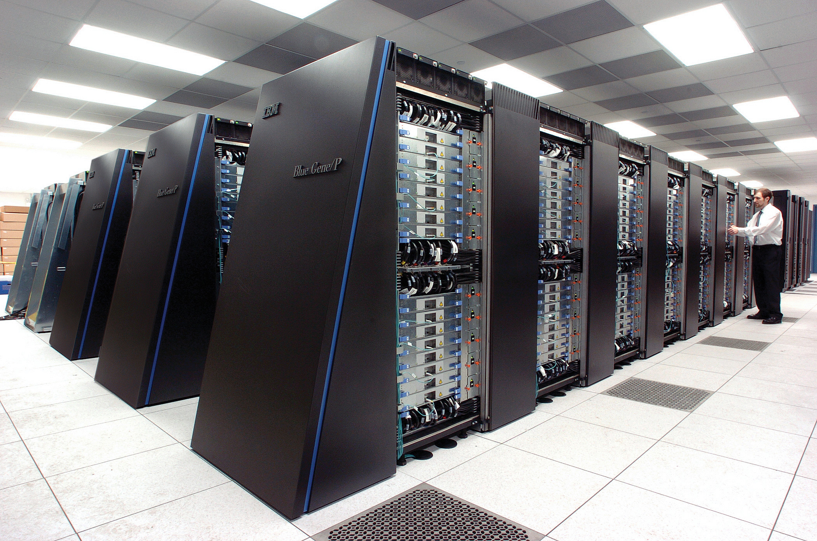
Super computers
Cray, Deep Blue, Blue Gene …
Specialized hardware
Extremely expensive
created to solve specialized important problems

Slide 3

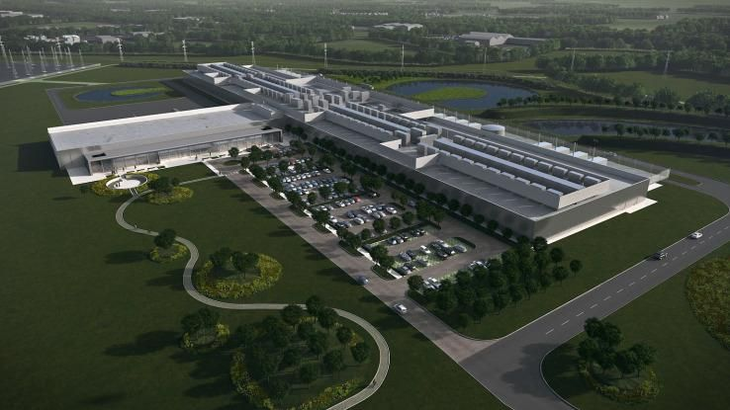
Data Centers

Slide 4
Data Centers
The physical aspect of ”the cloud”
Collection of commodity computers
VAST number of computers (100,000’s)
Created to provide computation for large and small organizations.
Computation as a commodity.

Slide 5
Making History: Google 2003
Larry Page and Sergey Brin develop a method for storing very large files on multiple commodity computers.
Each file is broken into fixed-size chunks.
Each chunk is stored on multiple chunk servers.
The locations of the chunks is managed by the master

Slide 6
HDFS: Chunking files
File 1, Chunk 1
Copy 2
File 1
Split
File 1, Chunk 1
Copy
File 1, Chunk 1
Copy 1
File 1, Chunk 2
Copy 2
File 1, Chunk 2
File 1, Chunk 2
Copy 1
File 1, Chunk 2
Copy 3
File 2, Chunk 1
Copy 2
File 2
Split
File 2, Chunk 1
Copy
File 2, Chunk 1
Copy 1
File 2, Chunk 2
Copy 2
File 2, Chunk 2
File 2, Chunk 2
Copy 1

Slide 7
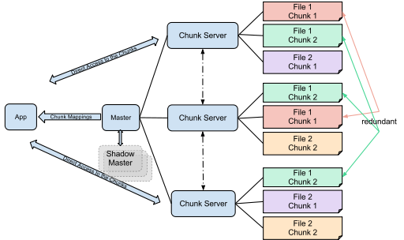
HDFS: Distributing Chunks
File 1, Chunk 1
Copy 1
File 1, Chunk 1
Copy 2
File 1, Chunk 2
Copy 1
File 1, Chunk 2
Copy 2
File 1, Chunk 2
Copy 3
File 2, Chunk 1
Copy 1
File 2, Chunk 1
Copy 2
File 2, Chunk 2
Copy 1
File 2, Chunk 2
Copy 2

Slide 8
Properties of GFS/HDFS
Commodity Hardware: Low cost per byte of storage.
Locality: data stored close to CPU.
Redundancy: can recover from server failures.
Simple abstraction: looks to user like standard file system (files, directories, etc.) Chunk mechanism is hidden.

Slide 9

Redundancy

Slide 10
Locality
Task:
Sum all of the elements in file 1

Slide 11
Map-Reduce
HDFS is a storage abstraction
Map-Reduce is a computation abstraction that works well with HDFS
Allows programmer to specify parallel computation without knowing how the hardware is organized.
We will describe Map-Reduce, using Spark, in a later section.

Slide 12
Spark
Developed by Matei Zaharia , amplab, 2014
Hadoop uses shared file system (disk)
Spark uses shared memory – faster, lower latency.
Will be used in this course
Recall word count by sorting, we will redo it using map-reduce!

Slide 13
The Cloud
The common name for data centers.
What is better? Cloud or your local computers?
Cloud vs. Local: Rent vs. own: if we want a lot of power for a short time, it is cheaper to rent.
Centralized IT: shared staff, shared maintenance, shared upgrade.
Storage:
Long term – cloud storage (multiple TB) much more expensive than local.
Moving TB to/from cloud slow / expensive / physical (snowball)
Like a huge supermarket, there are many choices and it is not easy to find the best combination.

Slide 14
Summary
Big data analysis is performed on large clusters of commodity computers. – computation as a service.
HDFS (Hadoop file system): break down files to chunks, make copies, distribute randomly.
Hadoop Map-Reduce: a computation abstraction that works well with HDFS
Spark: Sharing memory instead of sharing disk.

Slide 15
Spark Basics
Spark Context
Resilient Distributed Dataset (RDD)

Slide 16
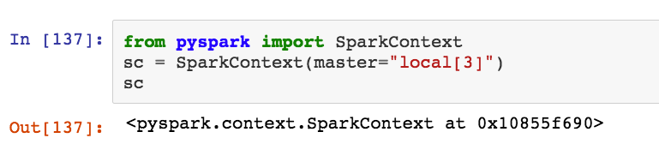
Spark Context
Spark is complex distributed software.
The python interface to spark is called pyspark
SparkContext is a python class, defined as part of pyspark which manages the communication between the user's program and spark.
We start by creating a SparkContext object named sc.

Slide 17
Resilient Distributed DataSets (RDDs)
Driver Node
Worker Node1 (CPU)
Worker Node3 (CPU)
Driver Program
(Python)
Executor 1
Worker Node2 (CPU)
Executor 3
RDD1
partitions1
RDD2
partitions1
Executor 2
RDD1
partitions3
RDD2
partitions3
RDD1
RDD2
RDD1
partitions2
RDD2
partitions2
Spark Context
(Scala)
Driver node
Driver Program
Spark Context
RDDs
Partitions
Executors

Slide 18
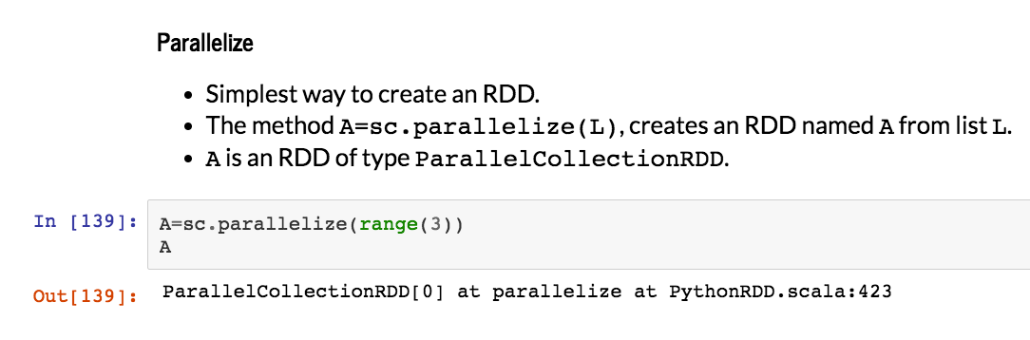

Slide 19
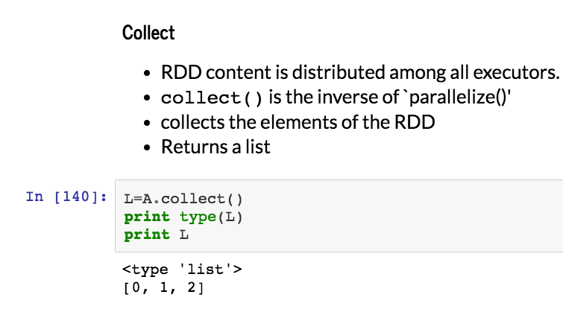

Slide 20
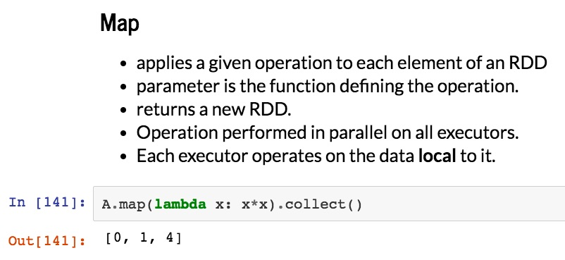

Slide 21
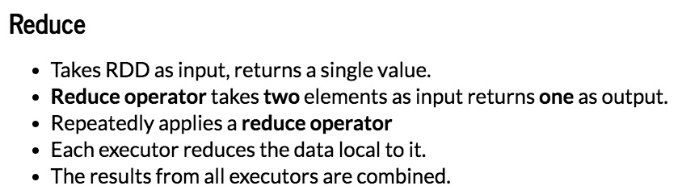

Slide 22
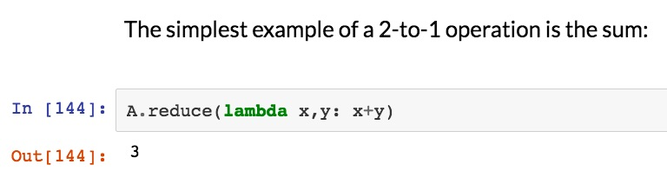

Slide 23
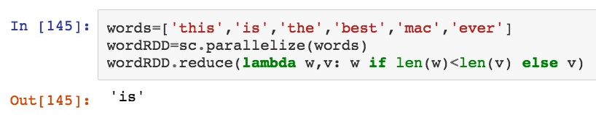
Another example:
Find the shortest word in a list

Slide 24
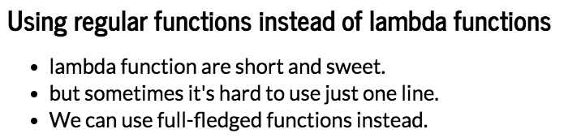

Slide 25
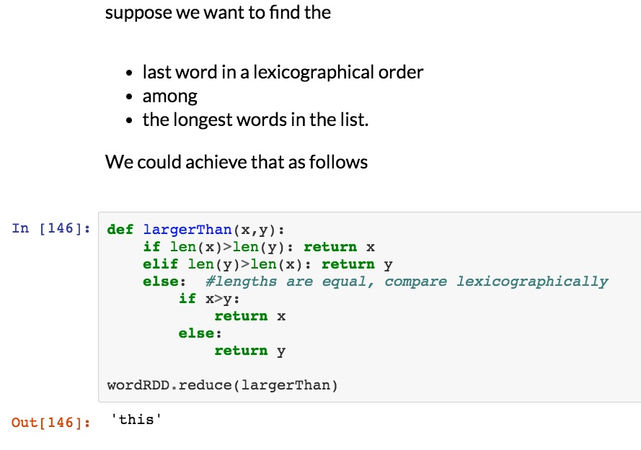

Slide 26
Summary
Spark - Context
RDDs
Map
Reduce
More details, and excercises, in the jupyter notebook.
Next time: more about RDDs

Slide 27
Distributed Sorting

Slide 28
Sorting Basics
Task: sort $n$ elements in increasing or decreasing order
Elements can be numbers, strings, keys…
Bubble sort: comparing neighboring entries: $O(n^{2})$ time
Quick-Sort Merge-Sort: $O(n\log{n})$ time
In general: $Ω(n\log{n})$ time is the best possible.
Bucket-sort: when distribution of the elements is known, it is possible to sort in $O(n)$ time

Slide 29

Distributed sorting
Suppose we want to sort a file of 60 GB distributed across 6 machines.
The main bottleneck is the communication between the machines.
Ethernet
Machine 1
Machine 2
Machine 3
Machine 4
Machine 5
Machine 6
Data 1
Data 2
Data 3
Data 4
Data 5
Data 6

Slide 30
Numbers
btwn
-10 and +30
Machine 1
Splitter
Data 1
$$−5$$
$$10$$
$$14$$
$$20$$
$$25$$
Machine 1
Machine 2
Machine 3
Machine 4
Machine 5
Machine 6
Data a
Data b
Data
c
Data d
Data e
Data
f

Slide 31
Machine 1
Machine 2
Machine 3
Machine 4
Machine 5
Machine 6
Data 1
Data 2
Data 3
Data 4
Data 5
Data 6
Splitter
Splitter
Splitter
Splitter
Splitter
Splitter
$$v_{1}$$
$$v_{2}$$
$$v_{3}$$
$$v_{4}$$
$$v_{5}$$
Ethernet
Machine 1
Machine 2
Machine 3
Machine 4
Machine 5
Machine 6
Data a
Data b
Data
c
Data d
Data e
Data
f

Slide 32
At the end , all elements in data a are smaller than all elements in data b, etc.
Pivot points: $Data_{a}≤v_{1}<Data_{b}≤v_{2}<{Data}_{c}≤⋯$
$$pivot_{1}$$
$$pivot_{2}$$
$$pivot_{3}$$
$$pivot_{4}$$
$$pivot_{5}$$
Ethernet
Machine 1
Machine 2
Machine 3
Machine 4
Machine 5
Machine 6
Data a
Data b
Data
c
Data d
Data e
Data
f

Slide 33
Finding good pivots
Goal: choose $v_{1},v_{2},…,v_{5}$ so that each of the 6 computers receives a similar number of points.
Restriction: Communicate a tiny fraction of the examples between computers.
Idea: Use sampling.

Slide 34
Pivot selection algorithm
Distributed Algorithm (Assuming $6$ computers, $5$ pivots, $k$ samples from each computer.)
Each computer selects $k$ examples uniformly at random
Aggregator Computer collects all $6k$ examples.
Aggregator sorts examples $x_{1}≤x_{2}≤⋯≤x_{6k}$
Aggregator chooses pivots to be $x_{k}≤x_{2k}≤x_{3k}≤x_{4k}≤x_{5k}$
Pivots distributed to all machines.
Clearly splits sample to 6 equal parts
Using Probability Theory: split all data to approximately equal parts even if the samples are small.

Slide 35
Organization of AWS EMR
S3
Long Term Storage
HDFS
Worker Nodes
Head node

